Slide 1


Pilot Study Update
Client: Exyte
Location: Singapore
Date : 20 Mar 2024

Slide 2
Note
Run 3 is completed on 13 Mar 24
Permeate fluoride ~ 6 mg/L, conductivity ~ 80 uS/cm
Pilot Study Recovery = 78.4%
Operating pressure 12 – 13 bar

Slide 3
HFW and LSR sampling points – Run 3
Sampling points | Volume (L) | Total volume for each collection (L) | Frequency in 2 days | Total quantity per tote (L)
HFW
HFW Gravity Drain A1 | 175 x 2 | 250 x 2 | 4 x 2 | 1000 x 2* (1m³)
HFW Gravity Drain A2 | 75 x 2
HFW Gravity Drain Chem Room | 5 x 2 | 5 x 2 |  | 20 x 2*
LSR A2
LSR A2 transfer pump | 250 x 2 | 250 x 2 | 4 x 2 | 1000 x 2 (1m³)
Ratio HFW A1: A2= 7:3
*Note: (1) 2 IBCs of HFW A1+A2 and LSR A2 (2) 2 carboys of HFW Chem Room will be collected
The mixing will be done in GIH lab
Sample to be collected 2 times a day in 2 days

Slide 4
Run 3 Water analysis
Sample | Feed | Reject | Permeate
pH | 8.6 | 7.85 | 9.39
Conductivity (µS/cm) | 2270 | 9604 | 80.0
Bicarbonate alkalinity | 74.0 | 284 | NA
Fluoride (mg/L) | 372 | 1736 | 5.95
Chloride (mg/L) | 26.9 | 100 | 1.53
Phosphate (mg/L) | 2.7 | 13.2 | <0.1
Sulfate (mg/L) | 4.03 | 13.7 | 0.128
Nitrate (mg/L) | 93.9 | 444 | 14
Ammonium as NH3-N (mg/L) | 17.2 | 66.6 | NA
Aluminium (mg/L) | 0.115 | 0.259 | <0.1
Boron (mg/L) | 1.62 | 10.5 | <0.1
Calcium (mg/L) | 0.842 | 1.49 | <0.1
Magnesium (mg/L) | <0.1 | 0.126 | <0.1
Iron as Fe (mg/L) | <0.1 | 0.422 | <0.1
Potassium (mg/L) | 1.28 | <0.1 | <0.1
Total Silica (mg/L) | 25.2 | 114 | <0.1
Sodium (mg/L) | 521 | 2565 | 16.3
TOC (mg/L) | 8 | 47.3 | 2.99
TDS (mg/L) | 1079 | 4905 | 37.4

Slide 5
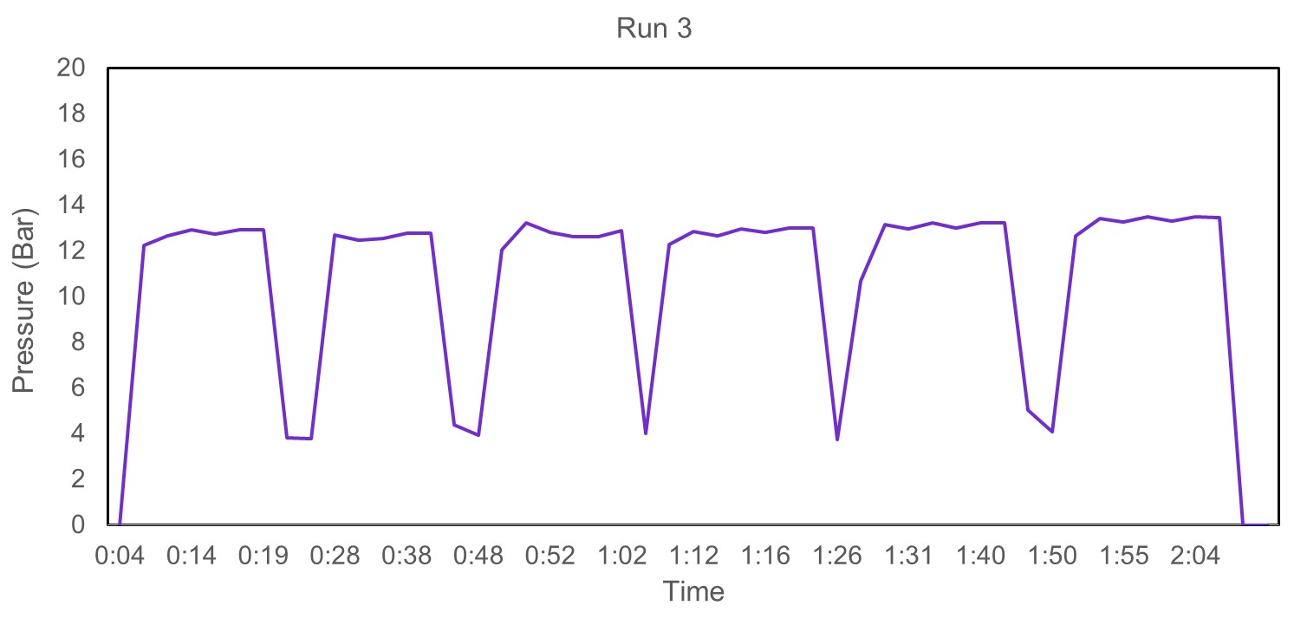
Run 3 RO pressure profile
Operating pressure = 12 - 13 bar
Service duration = 15 mins
Flushing duration = 110 sec
Notes:
Recovery on-site = 60-75% due to piping configuration on-site

Slide 6
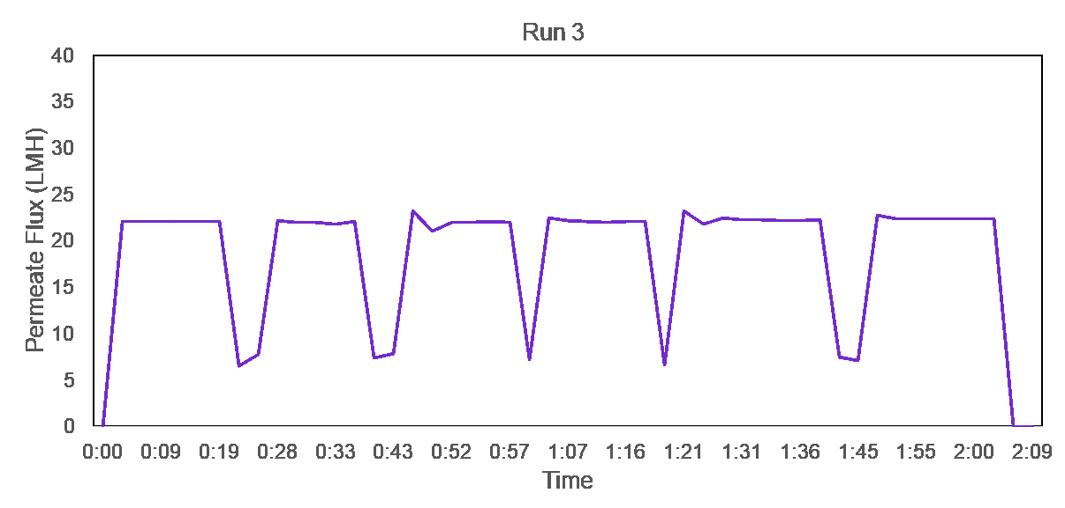
Run 3 RO permeate flux profile
Operating permeate flux = 22 LMH

Slide 7


Slide 8
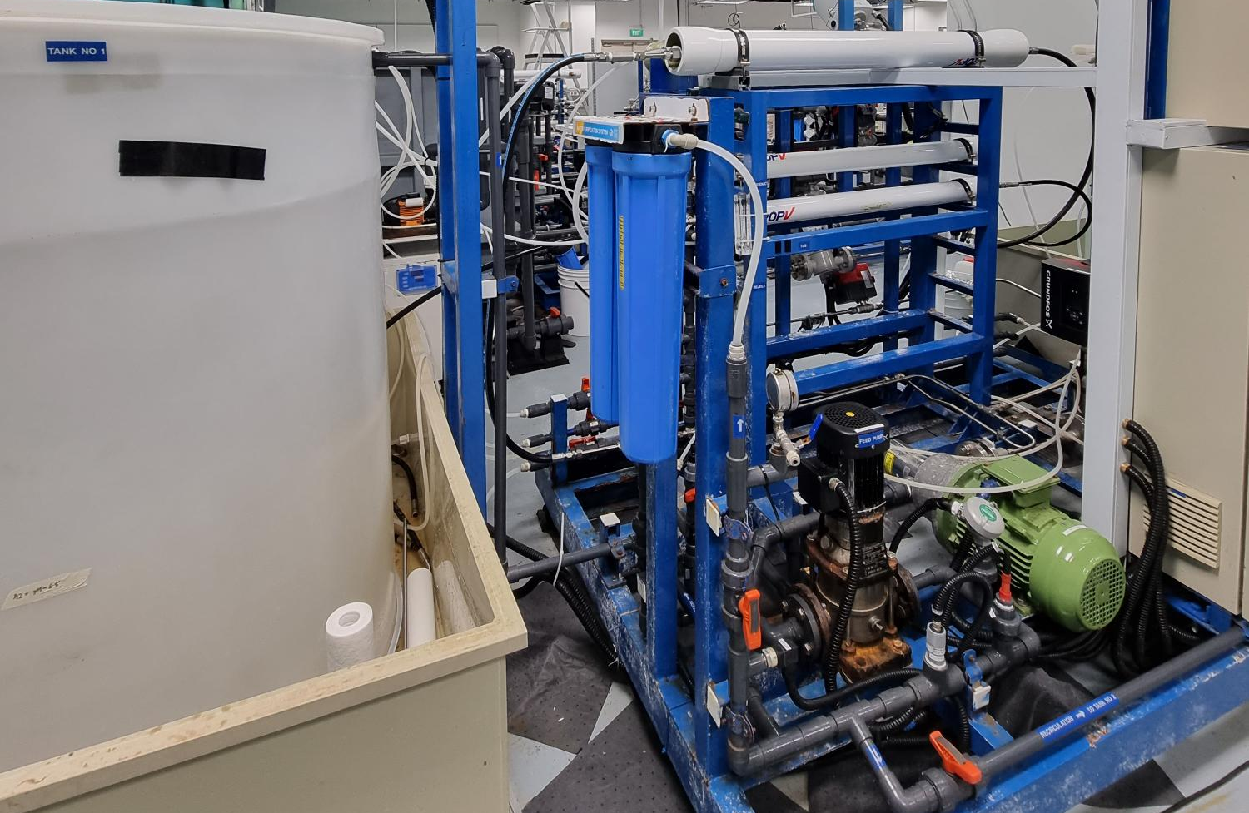
BW30 PRO-4040
Cartridge filter
Feed tank
Booster pump
High pressure pump
Notes:
Taking video for the setup, membrane autopsy after the end of the run?

